Slide 1
JSplitPane
Sara Carolina Gómez Delgado
ID: 0226594

Slide 2
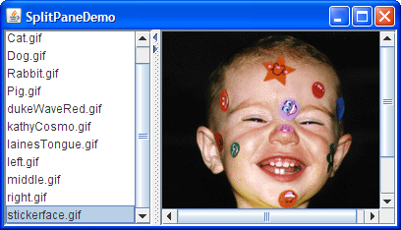
JSplitPane

Slide 3
JSplitPane
JSplitPane()
JSplitPane(int newOrientation)
JSplitPane(int newOrientation, boolean newContinuousLayout)
JSplitPane(int newOrientation, boolean newContinuousLayout,Component newLeftComponent, Component newRightComponent)
JSplitPane(int newOrientation, boolean newContinuousLayout,Component newLeftComponent, Component newRightComponent)

Slide 4
JSplitPane
public void setOrientation(int orientation)
public void serDividerLocation(int location)
public void setOneTouchExpandable(boolean newValue)

